Slide 1
In The Beginning There Was Hope
And Then
There Was
COVID-19
Notes:
2020 started the same as every other year we successfully navigated our planetary spaceship around our local star, and we decided that doing so is a good enough reason to celebrate. Collectively, as mankind, we are hopeful that this new year, as we are every year, will be a year of joy and prosperity. Little did we know what was waiting just over the horizon.

Slide 2
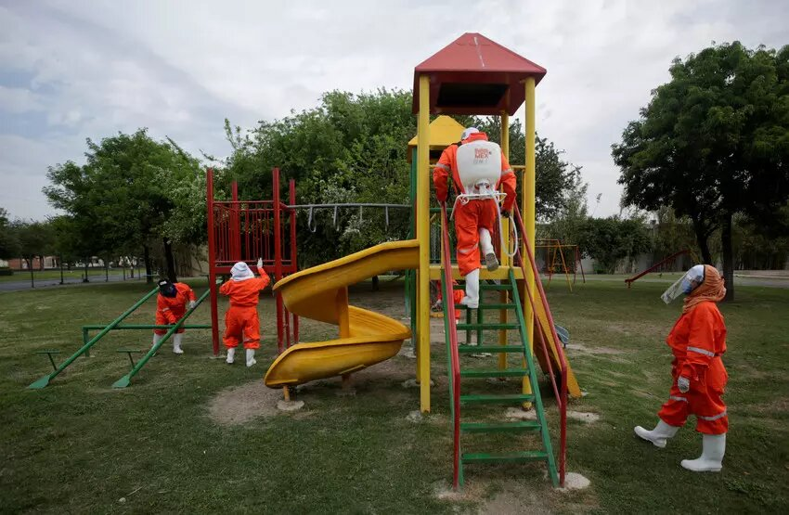
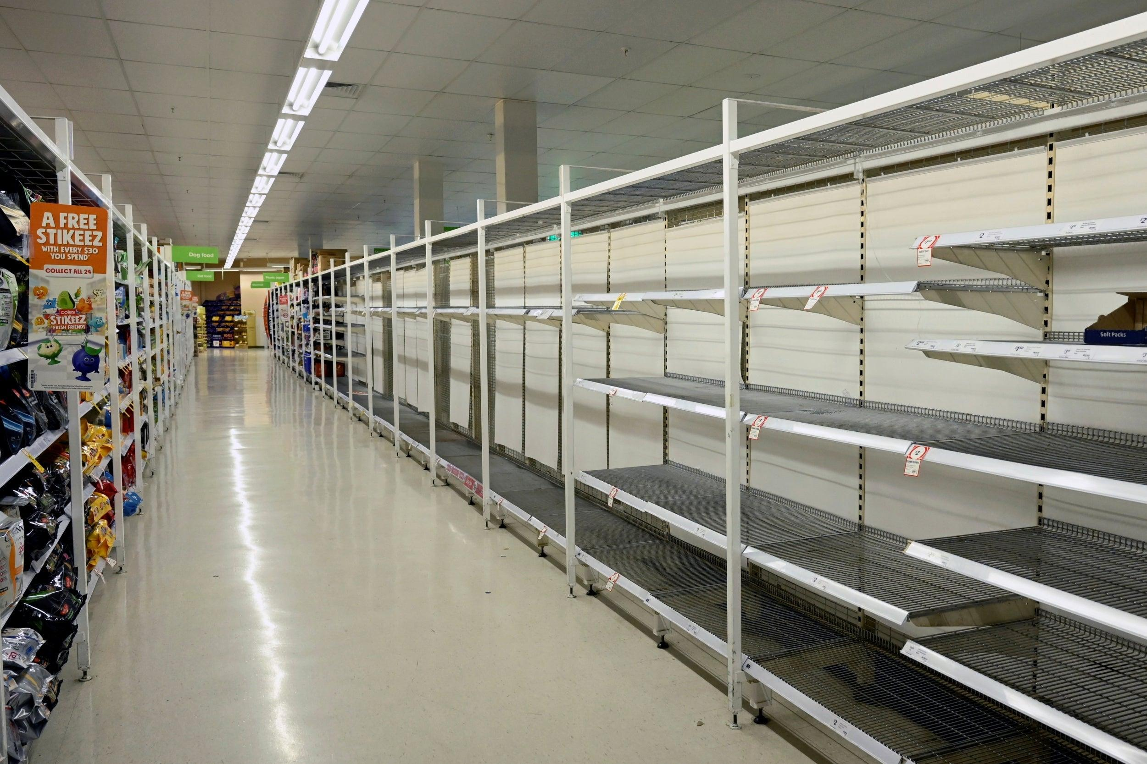
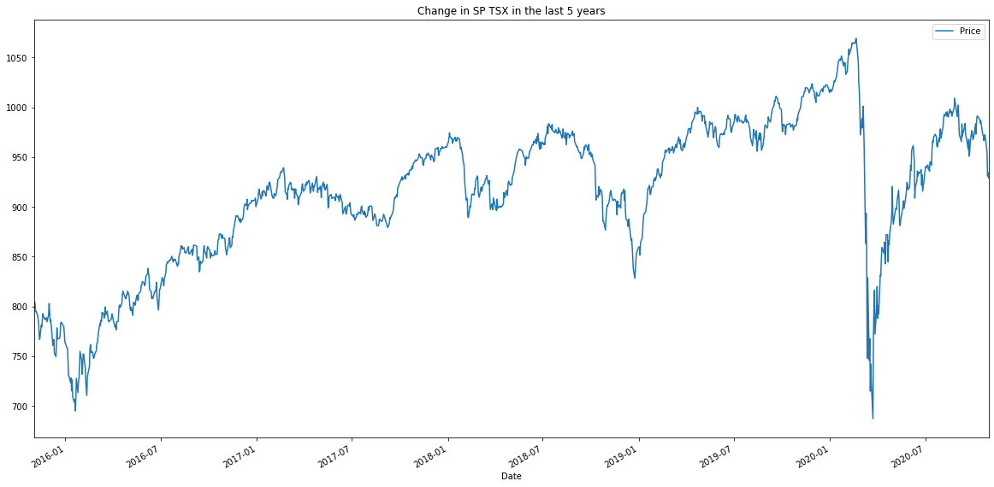


Impacts of
COVID-19
TSX-60
Google images
Notes:
Im sure you can remember where you were mid March as borders closed, quarantines were enforced, and the world descended into a state of pandemonium. These past 9 months have been eventfully uneventful for most of us. As such I'm going to do my best to keep this presentation some what interesting.
The global impacts of covid-19 are intricate and far-reaching. From supply chain, to unemployment, to faltering small businesses. Disecting such intricacies would be a monumental task for even the largest and most skilled team of analysts.
For that reason we decided to keep the scope of our project within Canada and focus on how the rise in covid cases impacted the Canadian stock market.

Slide 3
How Did Daily COVID Cases & Government Response Impact The Canadian Stock Market?
Team 5
Spencer Macey, Sebastien Vezina, Stephen Chen, Wazarat Hussain, Nick Yim
Notes:
How Did Daily COVID Cases & Government Response Impact The Canadian Stock Market?

Slide 4



How Did We Answer This Question?
Utilizing a variety of established online databases listed below, we were able to acquire reliable data that enable us to create visual and mathematical correlations using Python.
Big* Data:
Covid Cases In Canada
TSX-60 Data
Canadian Economic Response Plan
* Data may not be large enough for “Big” classification.
Notes:
GIS - ArcGIS is a geographic information system for working with maps and geographic information maintained by the Environmental Systems Research Institute
Investing.com - offers free real time quotes, portfolio, streaming charts, financial news, live stock market data and more.
Canadian gov - The canadian government has remained very open regarding its Economic response plan

Slide 5






Technical overview
Data sorting/analysis
Visualization
Notes:
We used a host of python libraries in our analysis, all of which we have used in class previously
All of our code is written in python and pandas in jupyter lab
Our visualizations were made in Plotly, mapbox, holoviews, matplotlib
Using these tools we were able to better understand our data and uncover interesting correlations.

Slide 6
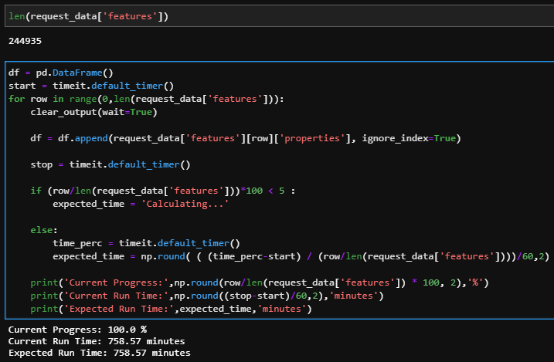
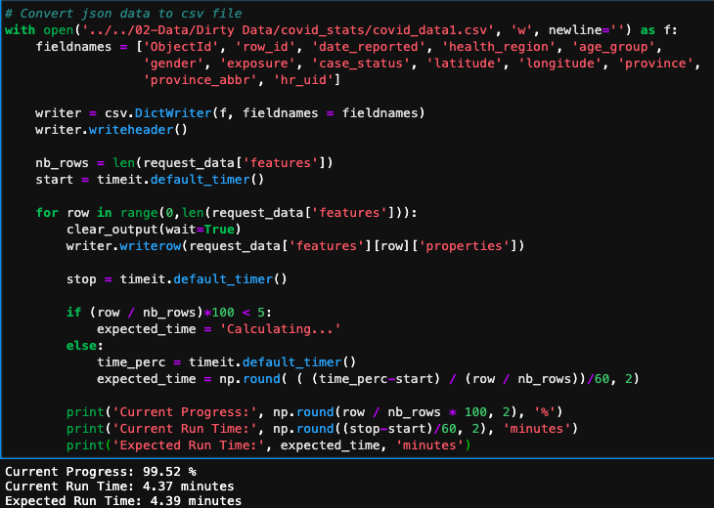
Sample codes
More Efficient Way
Execution Time: 4.39 min
What not to do!
Execution Time: 758 min = 12.7hrs
Notes:
When dealing with many rows (hundreds of thousands), using append() is the least efficient way to populate a DataFrame.

Slide 7
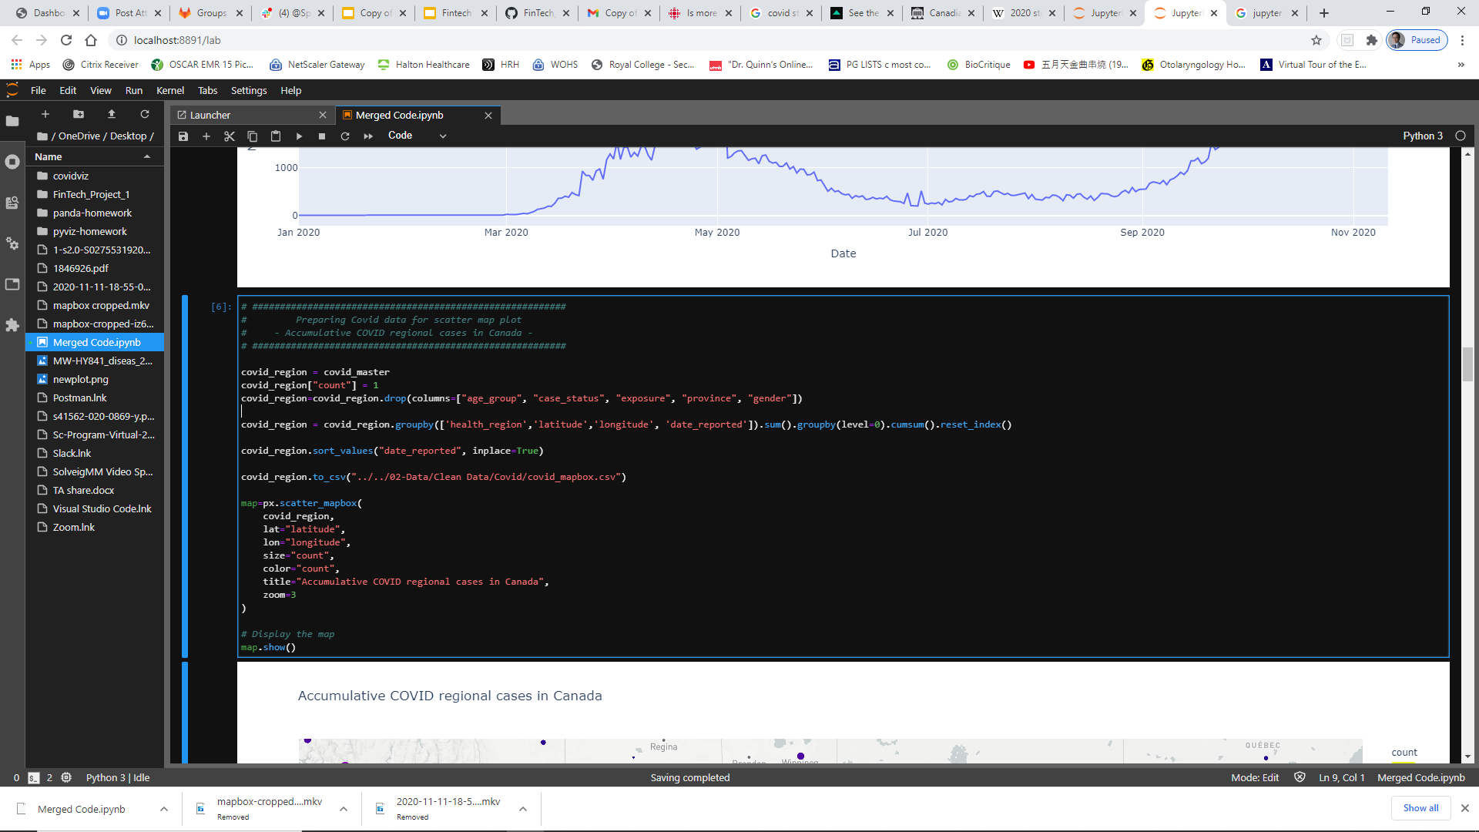

More sample codes
Tabulating regional cases on different days
Notes:
Don't let looks deceive you. Although this line of code may look very simple it took 3 of our team members a TA and our instructor nearly an hour to figure it out haha
When we pulled the covid cases dataframe in it came in as every row being one case in chronological order
What we were trying to achieve was a dataframe that was first organized by date, and then by locations.

Slide 8
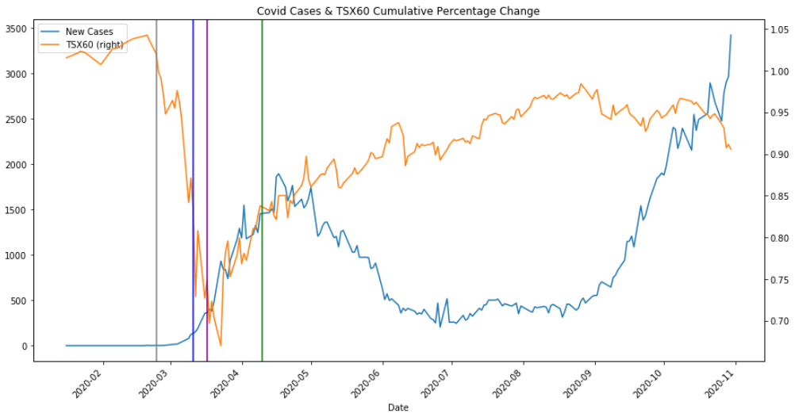
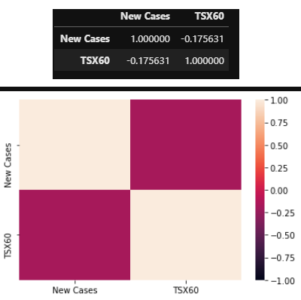
Covid TSX Analysis
(Jan 1, 2020 - Nov 3, 2020)
Notes:
Covid TSX analysis
Allow me to explain what exactly is going on here:
Blue is daily covid cases
Oronge is TSX price
Lines are
Jan 30th 2020 - WHO declared the outbreak a global public health emergency
Grey Feb. 24
Italy became the worst-hit country in Europe as cases spiked. Health officials announced the sixth death from the virus.
The U.S. stock market plummeted over coronavirus fears, after the Dow Jones Industrial Average experienced the worst day in two years.
Blue March 11, the WHO declared the existence of a global pandemic.
Red mar 17 Borders get locked down
Green April 10, the RCMP disclosed it has been asked to enforce the Quarantine Act, 2005
Right off the bat we ran a percent change on both datasets and calculated a correlation between them
We found a negative correlation between the two, with was to be expected.
But we were surprised that it was a small correlation.
Upon closer inspection we noticed that
The price of tsx jumped after every drop this is normal as traders buy back sold stock
What was interesting was that the bounch maintianed its strenth and continued to grow not only as daily covid cases soared but also as quarentien was enforced and many people were out of work
Why is that?

Slide 9
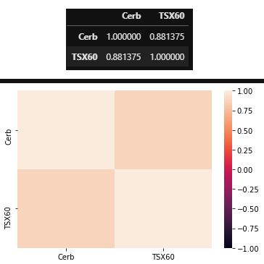
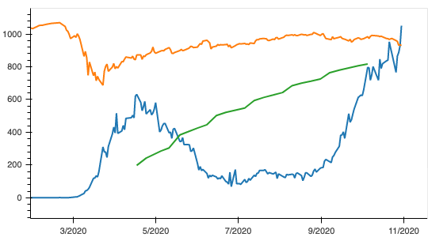
Canadian Economic Response Plan
Direct Support:
CERB: $81.64 Billion
CEWS: $83.60 Billion
CEBA: $13.75 Billion
CESB: $8.188 Billion
Other: $27.07 Billion
Total: $214.255 Billion
Total Support Given (Including Direct Support):
$686.450 Billion
Notes:
In short? Almost 700 Billion dollars worth of government subsidy and economic relief
This green line here is the dollar value of Only the CERB in hundreds of millions.
We looked for dataframes on the other benefits but was not able to find it in a format that we were looking for.
As such we were forced to therorize the exact impact the response benefits had.
The theroy we did come to was that the total dollar value of subsities given out acrross all of the direct benifits likelty fell in line with that of the cerb
The reason for that therory is that if consumors are applying for benifits it is likely because they are not reciving an income from their employers because the employers themselves could not afford to pay them, as such the total dollar value of subsidies given for business and wage subsidies would follow suit
You can see here in the graph that the tsx started climbing with the onset of cerb and started falling in line with the closer of cerb
Subsection title slide
https://www.canada.ca/en/innovation-science-economic-development/news/2020/05/covid-19-962-million-additional-support-fund-now-available-to-businesses-and-communities-affected-by-the-pandemic.html

Slide 10
Summary
As demonstrated from our correlation analysis, there is a weak negative correlation between new daily COVID-19 cases and TSX from Jan 1, 2020 till Nov 1, 2020.
This low correlation is due to the canadian government “propping up” the economy with large economic relief.
Without this financial support our economic situation would be very bleak

Slide 11
Limitations
Limited access to datasets, specifically on Economic response benefits.
It may still be too early to fully analyze the impact of COVID on the Canadian economy.
Notes:
Limitations:
-COVID has only really started impacting the economy in the last 6 - 7 months
-

Slide 12
Future directions
Correlation between specific time periods in COVID-19 cases and Canadian stock market (e.g. onset of pandemic)
To make an online dashboard that pulls and updates graphs with new data every day.

Slide 13
Thank you!

